Slide 1

Entrepreneurship: Successfully Launching New Ventures
Sixth Edition, Global Edition
Chapter 1
Introduction to Entrepreneurship
Notes:
If this PowerPoint presentation contains mathematical equations, you may need to check that your computer has the following installed:
1) MathType Plugin
2) Math Player (free versions available)
3) NVDA Reader (free versions available)

Slide 2
Learning Objectives (1 of 2)
1.1 Describe entrepreneurship, corporate entrepreneurship, and the characteristics of entrepreneurial firms.
1.2 Discuss three main reasons people decide to become entrepreneurs.
1.3 Identify four main characteristics of successful entrepreneurs.
1.4 Explain five common myths regarding entrepreneurship.
1.5 Describe three types of start-up firms.

Slide 3
Learning Objectives (2 of 2)
1.6 Discuss the changing demographics of entrepreneurs in the United States.
1.7 Discuss the positive effects of entrepreneurship and entrepreneurial firms on economies and societies.
1.8 Explain the entrepreneurial process.
1.9 Learn how understanding entrepreneurship and the
entrepreneurial process can facilitate career success.

Slide 4
Introduction to Entrepreneurship
There is tremendous interest in entrepreneurship in the U.S. and around the world.
According to the 2015/2016 G E M study, 11.9% of Americans are actively engaged in starting a business or are the owner/manager of a business that is less than three years old.

Slide 5
Indications of Increased Interest in Entrepreneurship
Books
  Amazon.com lists over 58,510 books dealing with entrepreneurship and 80,686 focused on small business.

Slide 6
What Is Entrepreneurship?
Academic Definition (Stevenson and Jarillo)
  Entrepreneurship is the process by which individuals pursue opportunities without regard to resources they currently control.
Alternative View
  Entrepreneurship is the art of turning an idea into a business.
Explanation of What Entrepreneurs Do
  Entrepreneurs assemble and then integrate all the resources needed – the money, the people, the business model, the strategy – to transform an invention or an idea into a viable business.

Slide 7
Corporate Entrepreneurship (1 of 2)
Corporate Entrepreneurship
  Is the conceptualization of entrepreneurship at the firm level.
  All firms fall along a conceptual continuum that ranges from highly conservative to highly entrepreneurial.
  The position of a firm on this continuum is referred to as its entrepreneurial intensity.

Slide 8
Corporate Entrepreneurship (2 of 2)
Entrepreneurial Firms
Proactive
Innovative
Risk taking
Conservative Firms
Take a more “wait and see” posture
Less innovative
Risk averse

Slide 9
Why Become an Entrepreneur?
The three primary reasons that people become entrepreneurs and start their own firms.
  Desire to be their own boss
  Desire to pursue their own ideas
  Financial rewards

Slide 10
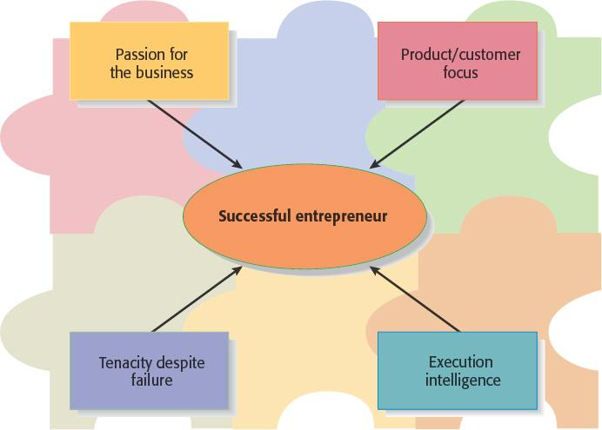
Characteristics of Successful Entrepreneurs (1 of 3)
Figure 1.1 Four Primary Characteristics of Successful Entrepreneurs

Slide 11
Characteristics of Successful Entrepreneurs (2 of 3)
Passion for the Business
  The number one characteristic shared by successful entrepreneurs is a passion for the business.
  This passion typically stems from the entrepreneur’s belief that the business will positively influence people’s lives.
Product/Customer Focus
  A second defining characteristic of successful entrepreneurs is a product/customer focus.
  An entrepreneur’s keen focus on products and customers typically stems from the fact that most entrepreneurs are, at heart, craftspeople.

Slide 12
Characteristics of Successful Entrepreneurs (3 of 3)
Tenacity Despite Failure
  Because entrepreneurs are typically trying something new, the failure rate is naturally high.
  A defining characteristic for successful entrepreneurs is their ability to persevere through setbacks and failures.
Execution Intelligence
  The ability to fashion a solid business idea into a viable business is a key characteristic of successful entrepreneurs.

Slide 13
Common Myths About Entrepreneurs (1 of 7)
Myth 1: Entrepreneurs Are Born, Not Made
  This myth is based on the mistaken belief that some people are genetically predisposed to be entrepreneurs.
  The consensus of many studies is that no one is “born” to be an entrepreneur; everyone has the potential to become one.
  Whether someone does or doesn’t become an entrepreneur is a function of their environment, life experiences, and personal choices.

Slide 14
Common Myths About Entrepreneurs (2 of 7)
Although no one is “born” to be an entrepreneur, there are common traits and characteristics of successful entrepreneurs
A moderate risk taker
Persuasive
Promoter
Resource assembler/leverager
Creative
Self-starter
Tenacious
Tolerant of ambiguity
Visionary
Optimistic disposition
A networker
Achievement motivated
Alert to opportunities
Self-confident
Decisive
Energetic
A strong work ethic
Lengthy attention span

Slide 15
Common Myths About Entrepreneurs (3 of 7)
Myth 2: Entrepreneurs Are Gamblers
  Most entrepreneurs are moderate risk takers.
  The idea that entrepreneurs are gamblers originates from two sources:
    Entrepreneurs typically have jobs that are less structured, and so they face a more uncertain set of possibilities than people in traditional jobs.
    Many entrepreneurs have a strong need to achieve and set challenging goals, a behavior that is often equated with risk taking.

Slide 16
Common Myths About Entrepreneurs (4 of 7)
Myth 3: Entrepreneurs Are Motivated Primarily by Money
  While it is naïve to think that entrepreneurs don’t seek financial rewards, money is rarely the reason entrepreneurs start new firms.
  In fact, some entrepreneurs warn that the pursuit of money can be distracting.

Slide 17
Common Myths About Entrepreneurs (5 of 7)
Myth 4: Entrepreneurs Should Be Young and Energetic
  Entrepreneurial activity is fairly evenly spread out over age ranges.
  While it is important to be energetic, investors often cite the strength of the entrepreneur as their most important criterion in making investment decisions.
    What makes an entrepreneur “strong” in the eyes of an investor is experience, maturity, a solid reputation, and a track record of success.
    These criteria favor older rather than younger entrepreneurs.

Slide 18
Common Myths About Entrepreneurs (6 of 7)
Table 1.4 Age Distribution of Business Owners
Age | Percentage of Business Owners
20-34 | 24.7
35-44 | 22.9
45-54 | 26.6
55-64 | 25.8
Source: R. W. Fairlie, A. Morelix, E.J. Reedy, and J. Russell, 2015 The Kauffman Index of Startup Activity: National Trends.

Slide 19
Common Myths About Entrepreneurs (7 of 7)
Myth 5: Entrepreneurs Love the Spotlight
  While some entrepreneurs are flamboyant, the vast majority of them do not attract public attention.
  As evidence of this, consider the following question: “How many entrepreneurs could you name?”
    Most of us could come up with Jeff Bezos of Amazon.com, Mark Zuckerberg of Facebook, Larry Page and Sergey Brin of Google or maybe Elon Musk of Tesla and SpaceX.
    But few could name the founders of Netflix, YouTube, or DIRECTV, even though we frequently use those firms’ services.

Slide 20
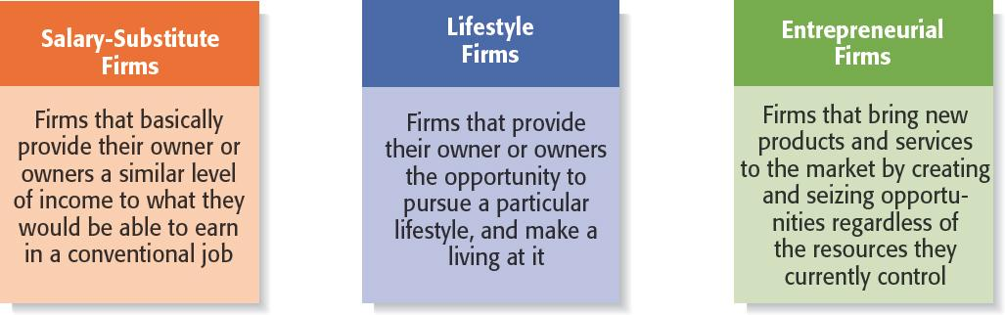
Figure 1.2 Types of Start-Up Firms

Slide 21
Changing Demographics of Entrepreneurs (1 of 5)
Women Entrepreneurs
  While men are more likely to start businesses than women, the number of women-owned businesses is increasing.
  According to a study commissioned by American Express OPEN, as of 2016, there were 11.3 million women-owned businesses in the United States.
  Over the past nine years, the number of women-owned businesses has grown at a rate five times faster than the national average.

Slide 22
Changing Demographics of Entrepreneurs (2 of 5)
Minority Entrepreneurs
  There has been a substantial increase in minority entrepreneurs in the United States.
  According to recent estimates, there are eight million minority-owned firms in the United States—a 38 percent increase since 2007.
  An important factor facilitating the growth of minority entrepreneurs is the number of organizations that promote and provide assistance.
    Examples include the Latin Business Association, the Black Business Association, and The National Center for American Indian Enterprise Development.

Slide 23
Changing Demographics of Entrepreneurs (3 of 5)
Senior Entrepreneurs
  The numbers of seniors starting businesses is substantial and growing.
  The percentage of individuals age 62 and older starting a business increased from 4.2 percent in 1988 to 5.4 percent in 2015.
  Many people in the 60 and older age range have substantial business experience, financial resources, and excellent vigor and health.
    This makes them excellent candidates to start businesses in many industries.

Slide 24
Changing Demographics of Entrepreneurs (4 of 5)
Millennial Entrepreneurs
  A desire to pursue an entrepreneurial career is high among millennials.
  Despite this desire, in 2013 only 3.6 percent of all businesses in the United States were owned by someone under the age of 30.
  A 2016 study by EY and EIG found that the biggest obstacles preventing millennials from starting businesses are lack of finances, lack of desire, fear of failure, and lack of knowledge of the business start-up process.

Slide 25
Changing Demographics of Entrepreneurs (5 of 5)
Millennial Entrepreneurs (continued)
  There are many factors at work to encourage millennials to consider entrepreneurship as a career.
  More than 2,300 colleges and universities in the United States offer at lease one course in entrepreneurship.
  A number of organizations have been established to encourage college students to consider becoming entrepreneurs.
    These include 3-Day Startup, Dorm Room Fund, CEO (Collegiate Entrepreneurs’ Organization), Startup Weekend, and VentureWell.

Slide 26
Economic Impact of Entrepreneurial Firms
Innovation
  Is the process of creating something new, which is central to the entrepreneurial process.
  Small innovative firms are 16 times more productive than larger innovative firms in terms of patents per employee.
Job Creation
  Small businesses create a substantial number of net new jobs in the United States.
  Firms with 500 or fewer employees created two million of the roughly three million private sector jobs in 2014.

Slide 27
Entrepreneurial Firms’ Impact on Society and Larger Firms
Impact on Society
  The innovations of entrepreneurial firms have a dramatic impact on society.
  Think of all the new products and services that make our lives easier, enhance our productivity at work, improve our health, and entertain us.
Impact on Larger Firms
  Many entrepreneurial firms have built their entire business models around producing products and services that help larger firms become more efficient and effective.

Slide 28
The Entrepreneurial Process
The Entrepreneurial Process Consists of Four Steps
Step 1: Deciding to become an entrepreneur.
Step 2: Developing successful business ideas.
Step 3: Moving from an idea to an entrepreneurial firm.
Step 4: Managing and growing the entrepreneurial firm.

Slide 29
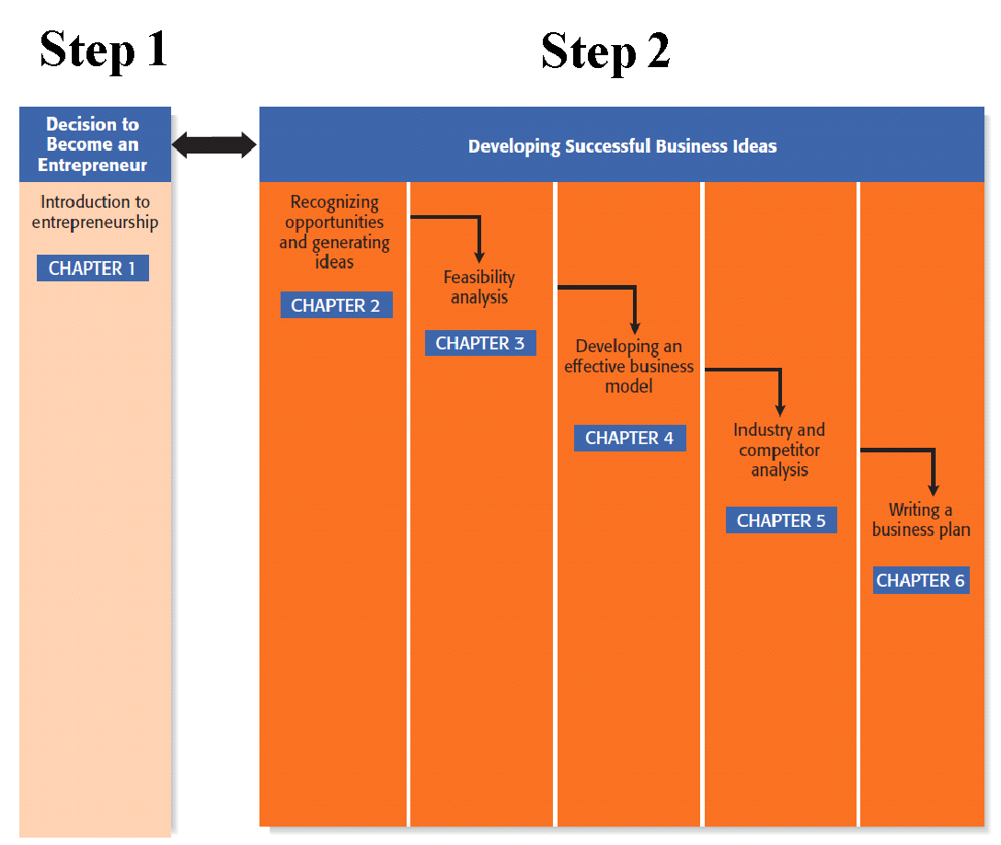
Steps in the Entrepreneurial Process (1 of 2)

Slide 30
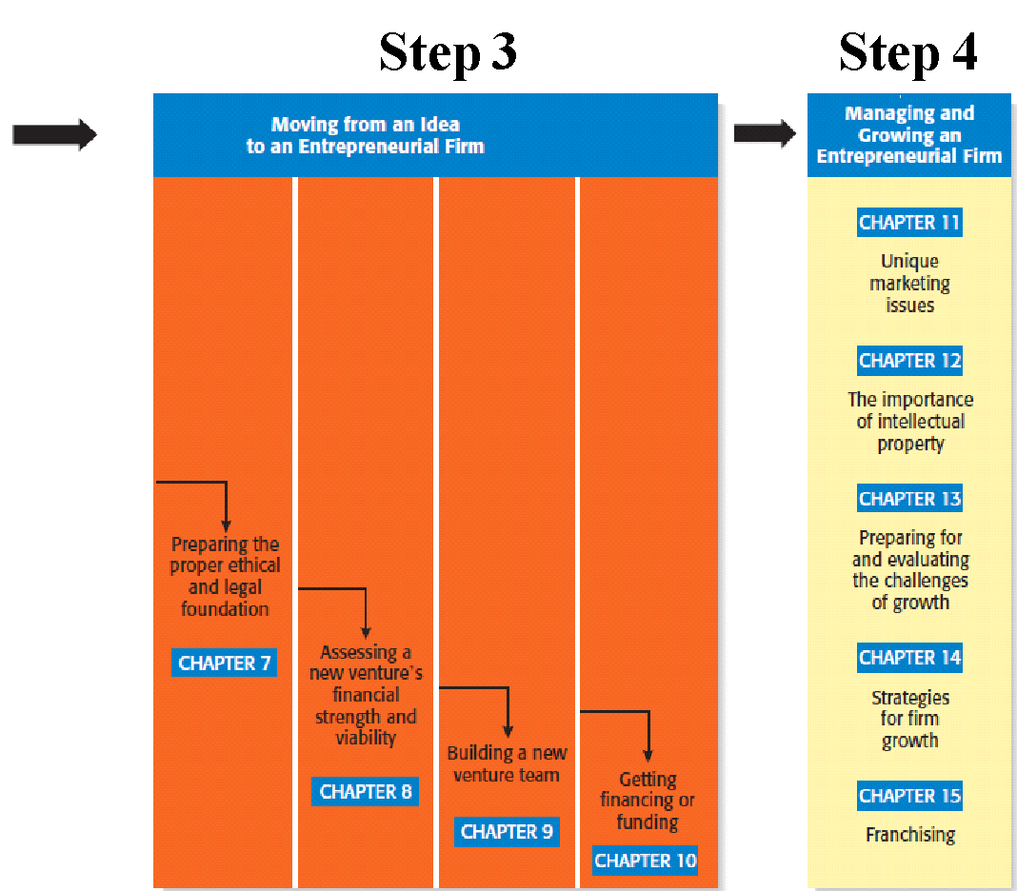
Steps in the Entrepreneurial Process (2 of 2)

